Slide 1
Start
AN APPLIED APPROACH TO FOREX MARKET PREDICTION
USING MACHINE LEARNING
Examiner :
Prepared by :
Cheng Yun
MCS241014
17 Jan2025

Slide 2

BACKGROUND OF STUDY
01
PROBLEM STATEMENT
The frequent fluctuations of foreign exchange lead to substantial significant financial challenges for global businesses
Meantime in this aspect of the country , the consequences of FOREX instability also displays a tragic picture.
develop effective tools to predict and mitigate the effects of currency fluctuations on both macroeconomic stability and social well-being.
Normally, many people face the problem of lacking valuable financial knowledge, rather than the Forex market.
International businesses face Forex risk in nearly every transaction, which can decrease interest and increase costs if exchange rates shift unstably.
chengyun@graduate.utm.my

Slide 3
RESEARCH OBJECTIVES
02
RESEARCH QUESTIONS
To analyse the trend of interest rate,exchange rate of USD/CNY,CPI and 10-year bond from 2014 to 2024.
To predict the future exchange rate of USD/CNY with interaction of crucial indicators by using the Long short-Term Memory (LSTM) model
How does the interest rate impact the pairs USD/CNY exchange rate from 2014 to 2024?
Which variables have played a significant role in the movement of FOREX?
How does the LSTM model forecast the future exchange rate of pairs USD/CNY?
chengyun@graduate.utm.my

Slide 4
SIGNIFICANT OF STUDY
03
SCOPE & LIMITATIONS
FUTURE RESEARCHERS
Improve the ability to develop more advance model.
GOVERNMENT
Supervising economic inflation,and making appropriate interest policy.
INVESTOR
Avoiding the risk from market
PUBLIC
Covers the relationship of interest, CPI and exchange rate Index in China and US.
The results cannot represent other countries except China and US.
Only focuses on the FOREX Unpredictably occurring events.
chengyun@graduate.utm.my

Slide 5
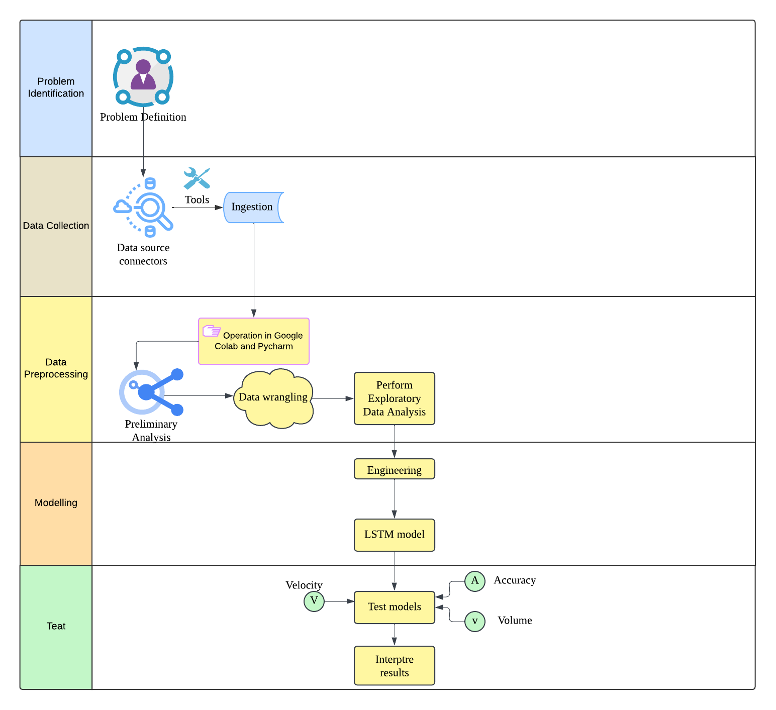
RESEARCH METHODOLOGY
06
PROBLEM FORMULATION
DATA DESCRIPTIONS
10-years bond, interest, CPI, exchange rate between USD and CNY from 2014to 2024.
DATA PRE-PROCESSING
Preliminary analysis Data Cleaning
Data Concatenation Data Visualization
DATA MODELLING
chengyun@graduate.utm.my

Slide 6
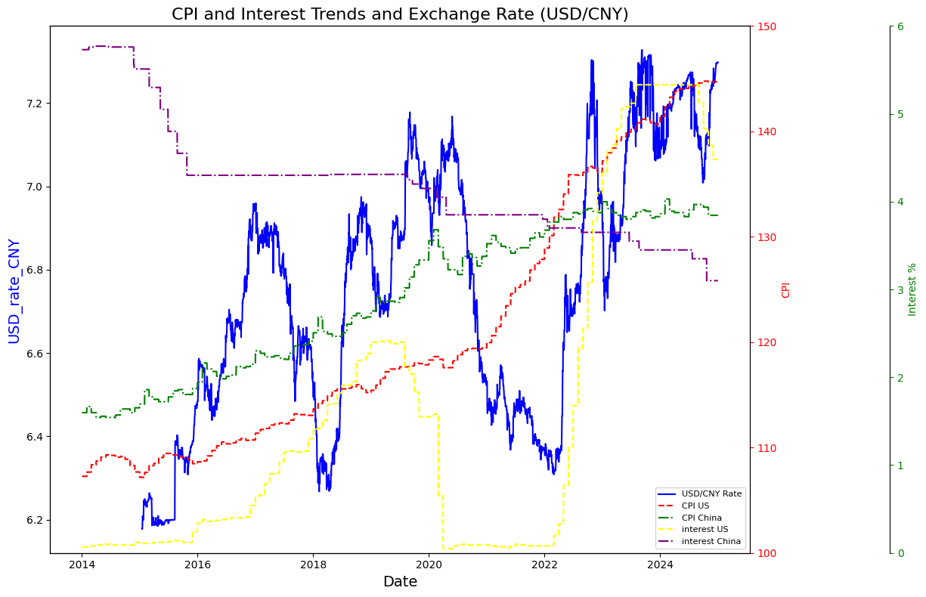
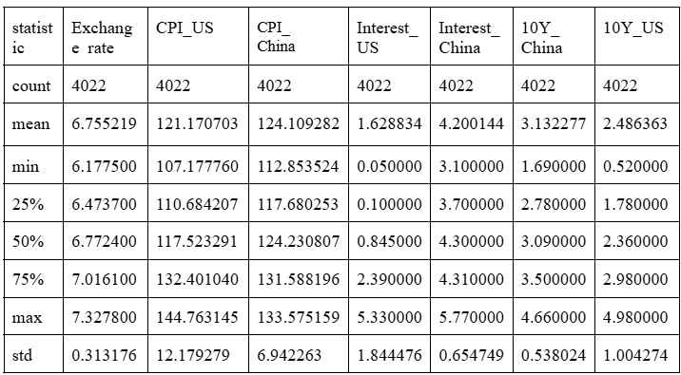
INITIAL RESULT
07
1. TREND OF EACH VARAIBLES
2. DESCRIPTIVE ANALYSIS
chegnyun@graduate.utm.my

Slide 7
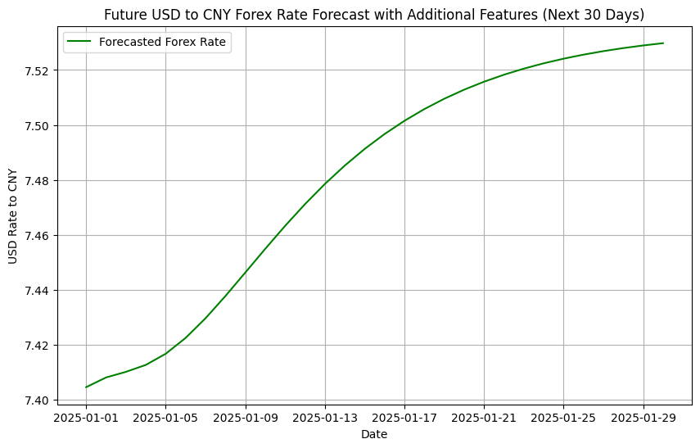
INITIAL RESULT
09
1. Initial Result
2. RESULT Discussion
From the graph, it can probably be concluded that over the next 30 days, the USD displays a strong and dynamic influence in the FOREX market against the Chinese Yuan. By contrary, the Chinese currency interprets a consistent weakening trend in the financial market,because of a potential decreasing interest rate environment.
chengyun@graduate.utm.my

Slide 8
FUTURE WORKS
10
Discussion
1. TREND ANALYSIS AND ECONOMIC INFLUENCE
conclude that interest is a major and significant factor which affect the change of the FOREX.Furthermore,CPI and 10-year bond also plays an important role in the movement of the FOREX by directly affecting the interest.
Gaps and Suggestions for mdoels
Government and Investor Implications
LSTM model
convey and convert past patterns in the exchange rate and these influencing factors to detect deep relationships and predict future trends.
chengyun@graduate.utm.my

Slide 9
Finish
THANK YOU
Examiner :
Prepared by :
Cheng Yun
MCS241014
chengyun@graduate.utm.my

